Slide 1
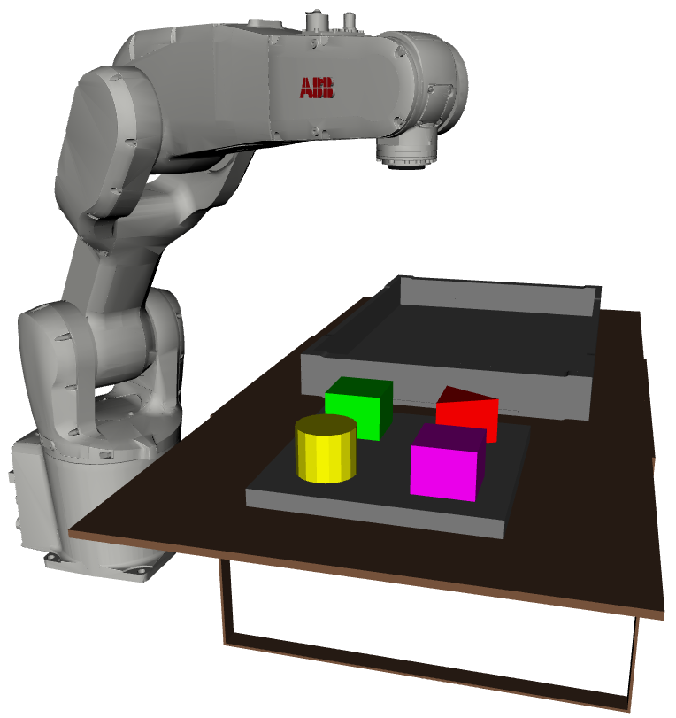

Prototyping Project
Bin Picking
Timur Kuzu
Dominik Leitner
Orhun Oezcan

Slide 2
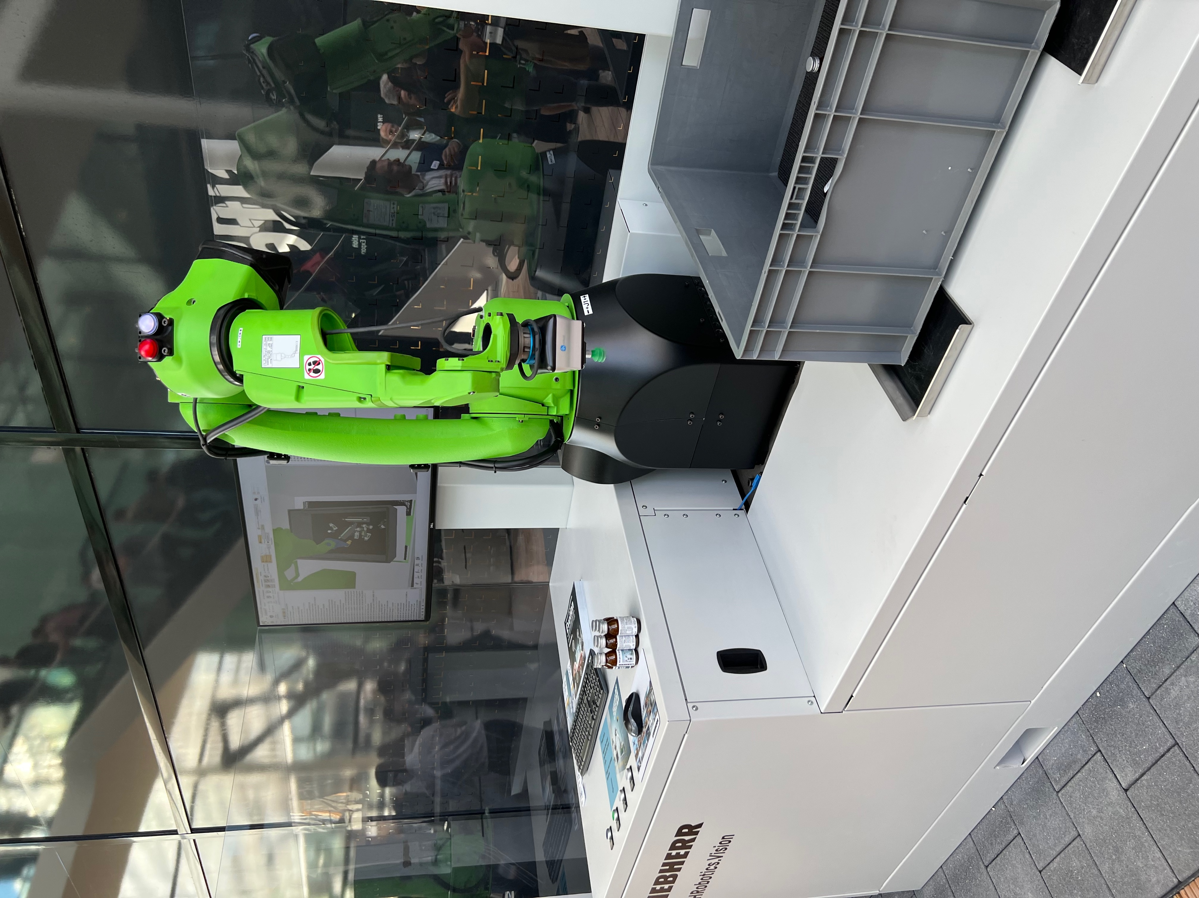
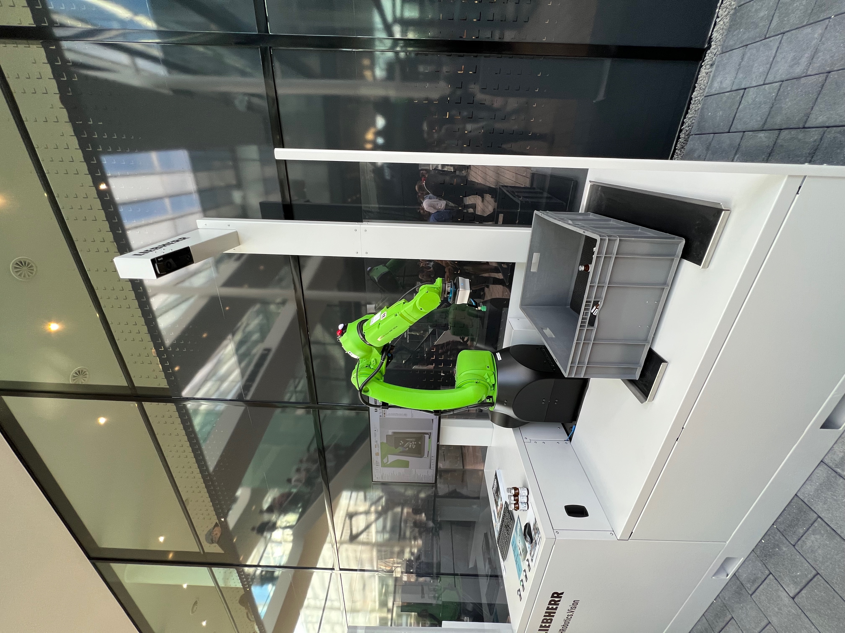
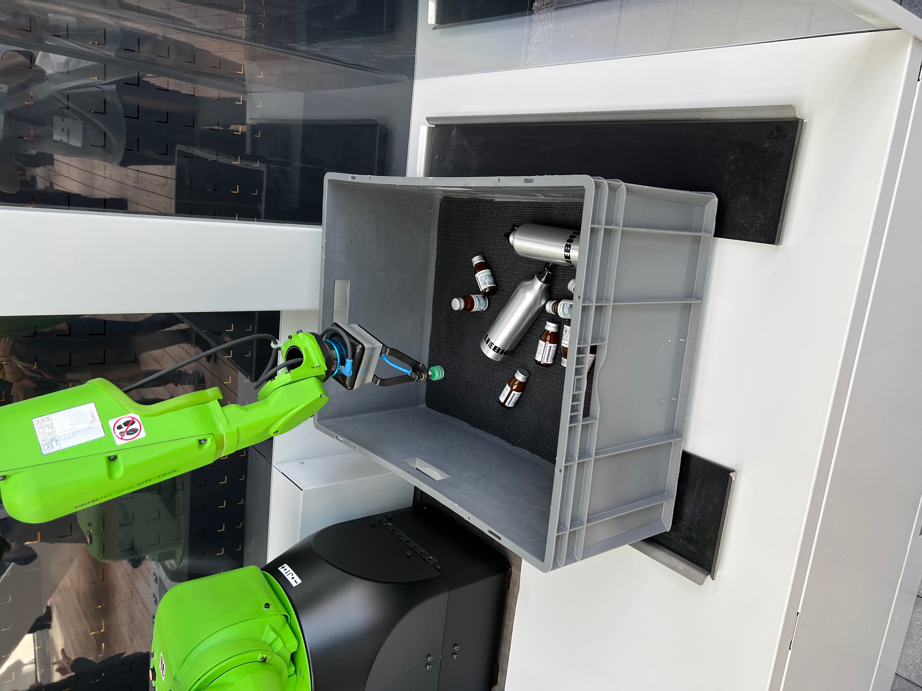
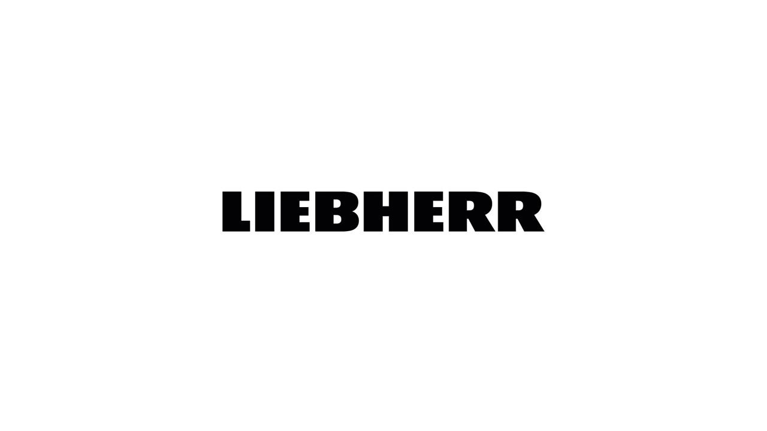
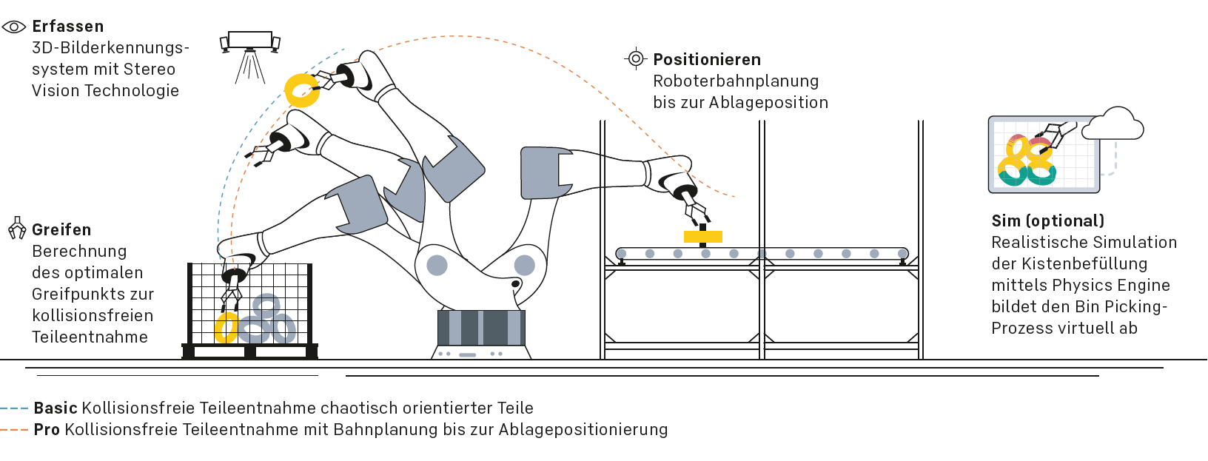
Prototyping Project
Bin Picking
Introduction
LIEBHERR x FANUC - BAUMA 2022
The robot is able to identify and locate specific objects inside a bin, pick the item and place it in a designated target location.
The removal of disorderly provided parts from containers and their correct, oriented placement in a workpiece carrier is child's play for the human brain. For the robot, on the other hand, it is a Herculean task, as it requires complex interaction between the image recognition system, software, gripping technology and robot due to the chaotic initial situation.
Credits: Image and Video by Liebherr (Verzahntechnik GmbH)
https://www.youtube.com/watch?v=-PjGzlYVw8U&ab_channel=Liebherr ; https://www.liebherr.com/shared/media/gear-technology-and-automation/broschures/automation/robot-systems/liebherr_roboterapplikationen_de.pdf
accessed 13/02/2022, slide by Timur Kuzu, Dominik Leitner and Orhun Oezcan

Slide 3
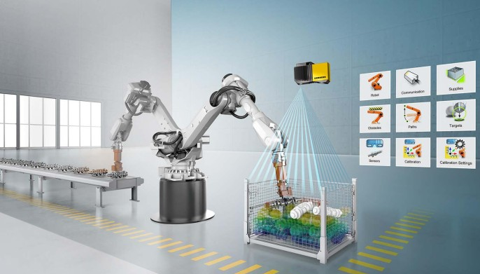
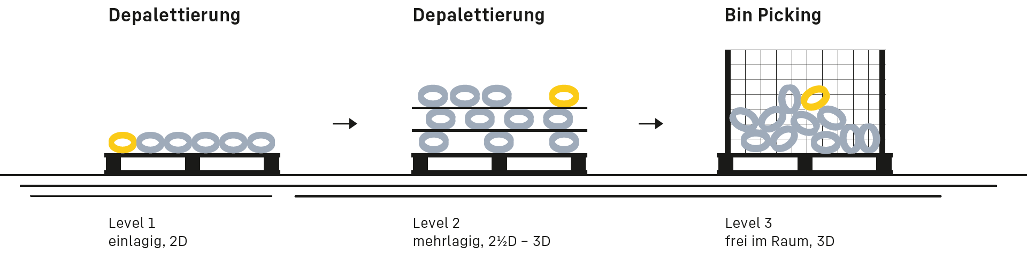
Prototyping Project
Bin Picking
Industry Application
Lifting and positioning heavy parts from a box is an unergonomic, monotonous and sometimes unsafe task
robotic automatization
Benefits:
Physical relief for employees and avoidance work accidents
Increase in machine running time → unmanned shifts
Fast cycle times → productivity increase
False part exclusion
→ More profitable process
Possibilities:
Credits: Images by Liebherr (Verzahntechnik GmbH)
https://bit.ly/3DZmxXK ; https://www.liebherr.com/shared/media/gear-technology-and-automation/broschures/automation/robot-systems/liebherr_roboterapplikationen_de.pdf
accessed 13/02/2022, slide by Timur Kuzu, Dominik Leitner and Orhun Oezcan

Slide 4
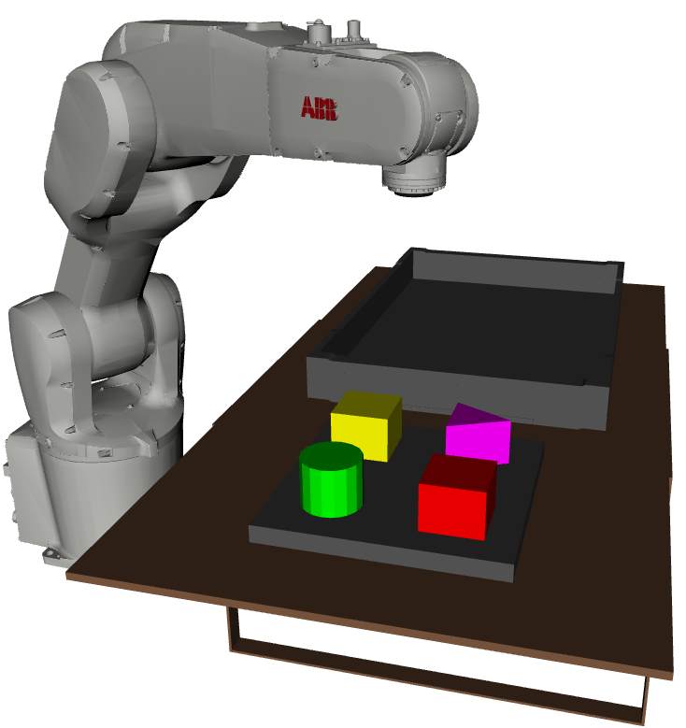
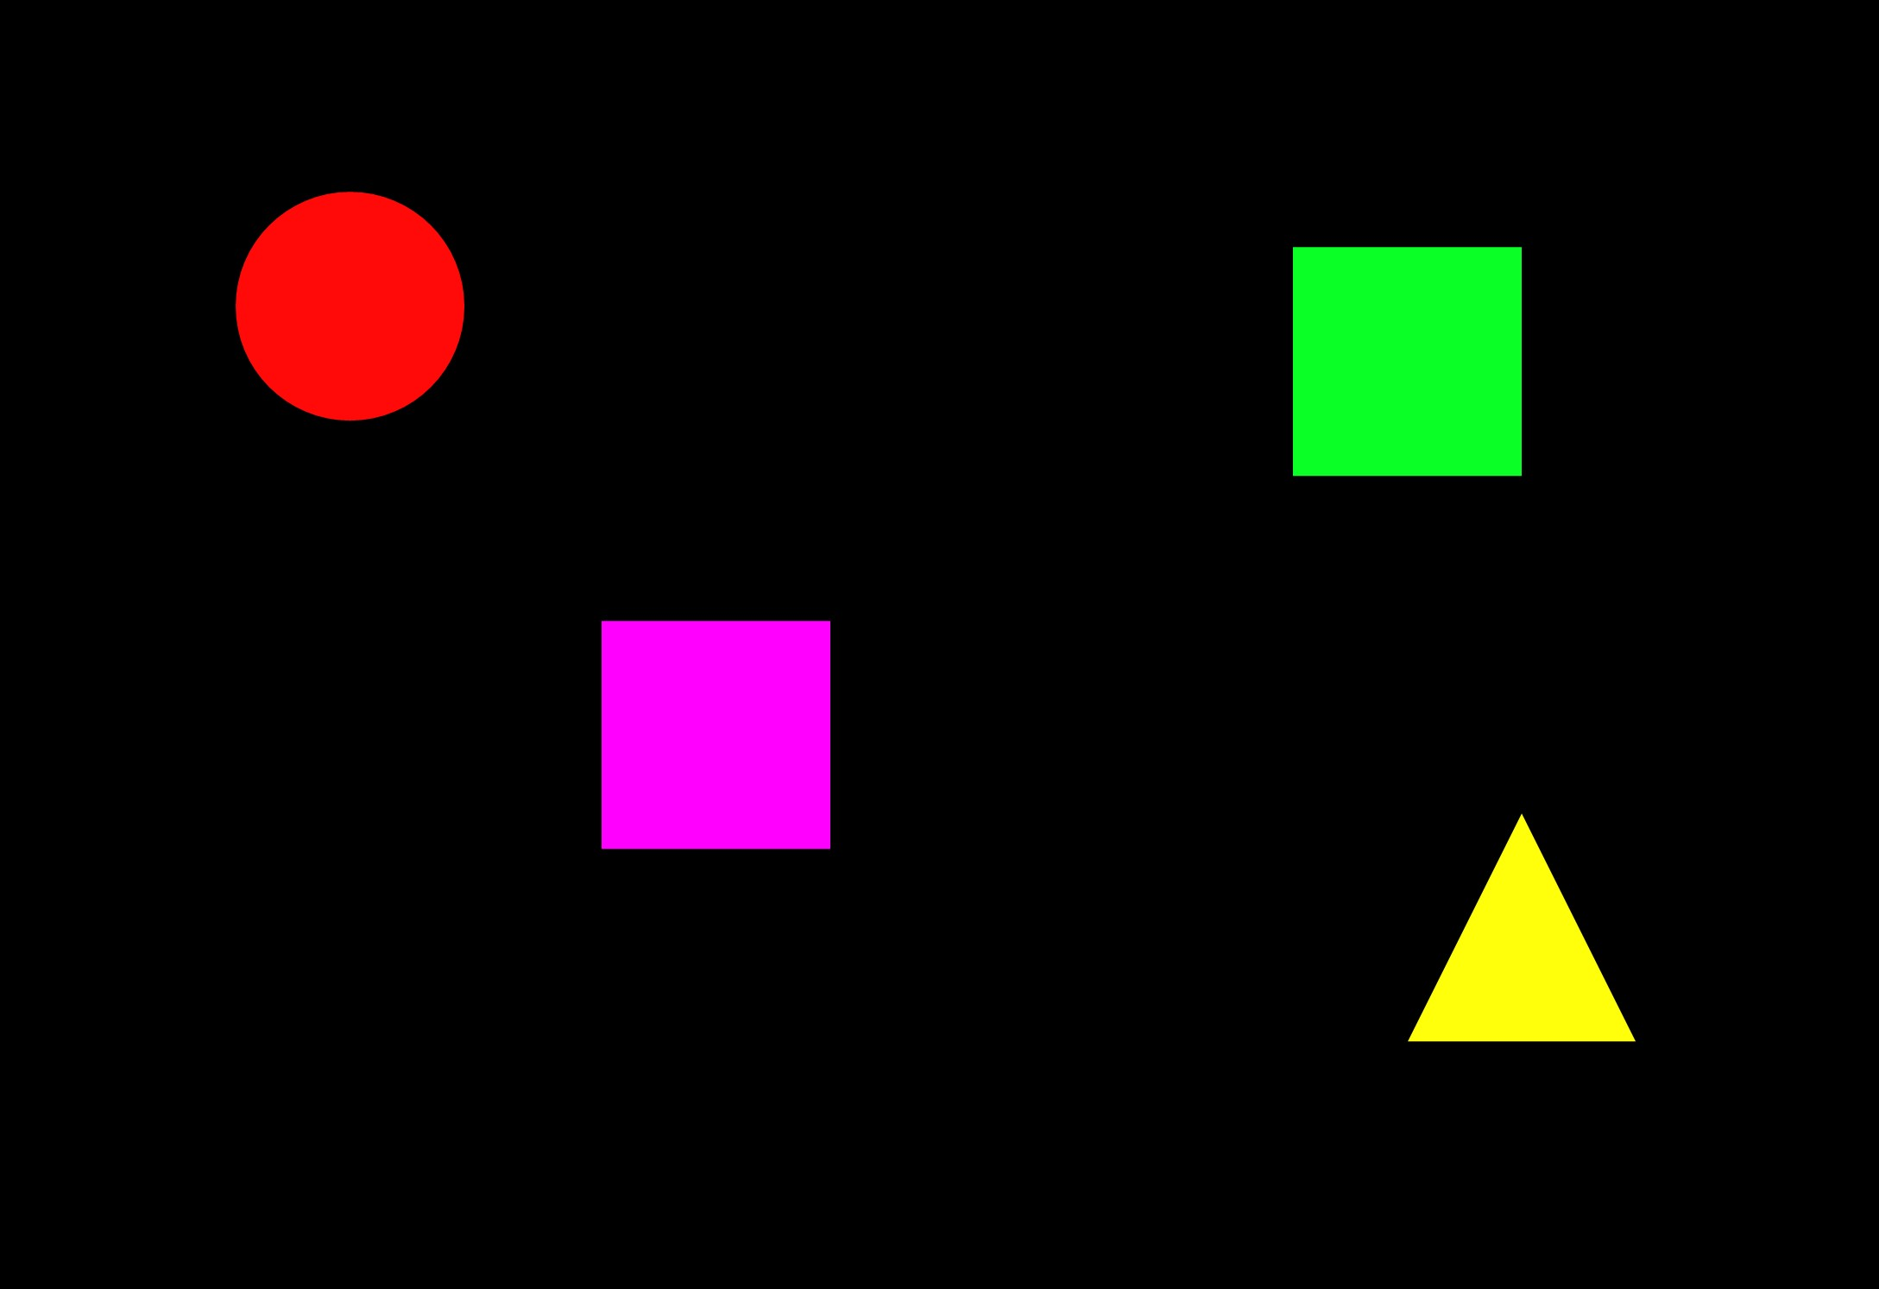
Prototyping Project
Bin Picking
Research Process
Description:
Camera takes picture of objects in a box → Object Identification
→ Evaluate position of objects and feed to robot
Move robot to object and grasp object → Object is moved to end position
and released
Prototyping Goals:
Model Robot
Implement object detection from picture
Evaluate position of objects relative to robot → model pathway start to end position
Additional Goals:
Inverse kinematics
Add different objects and place on selected surface
From an Image
To a Robot Process
Object Identification
Environment Robot
Staffage
Movement Kinematics
Path Planning
Data Transfer
Communication
Robot
in action
Challenges
Future Work
accessed 12/02/2022, slide by Timur Kuzu, Dominik Leitner and Orhun Oezcan

Slide 5
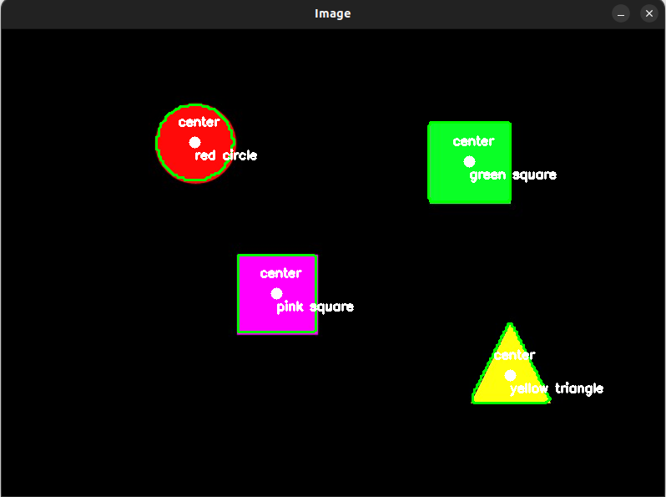
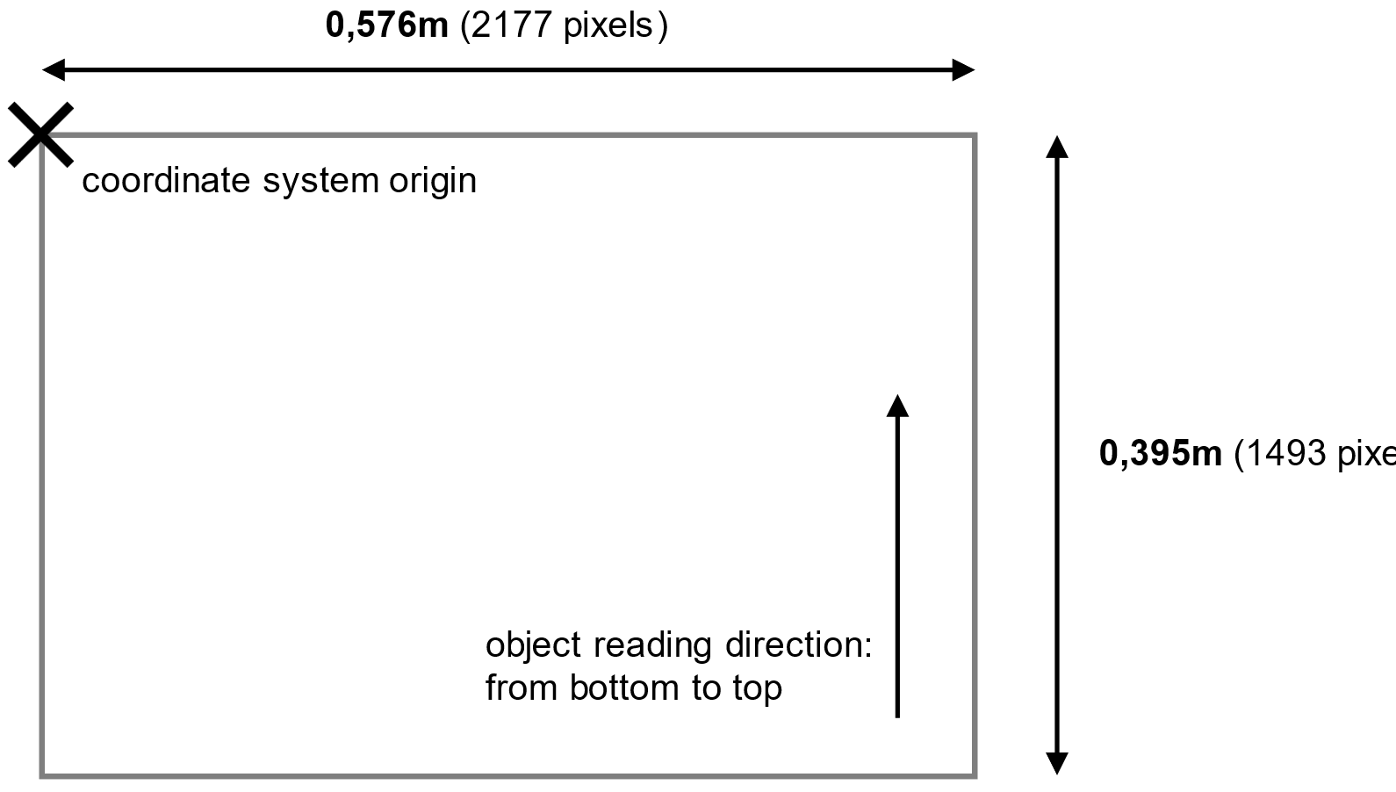
Prototyping Project
Bin Picking
Object Identification
1.) Compute the contours and centers:
• Grayscale Conversion
• Blurring
• Binarization: by thresholding
2.) Recognition of various object shapes:
The number of vertices of the determine the geometric output shape
e.g.: three vertices for a triangle, four vertices for a square, etc.
3.) Colour labelling of the objects:
Possible colours are pre-defined in a colour dictionary
4.) Object Identification output format:
The detection and coordinate output sequence for the objects is predefined by OpenCV
Object Idenfification sub-tasks:
Compute
the contours and centers
Recognition
of various object shapes
Colour labeling
of the objects
Object Identification
output format
0,395m
(1493 pixels)
accessed 13/02/2022, slide by Timur Kuzu, Dominik Leitner and Orhun Oezcan

Slide 6
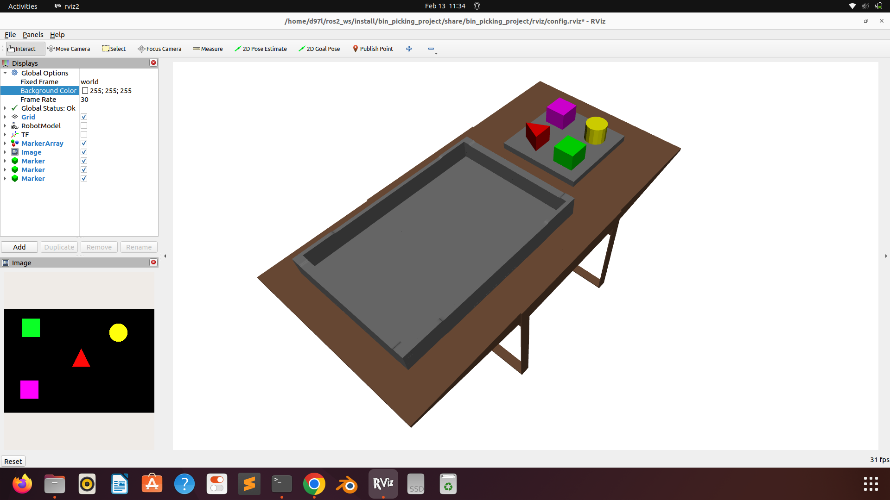
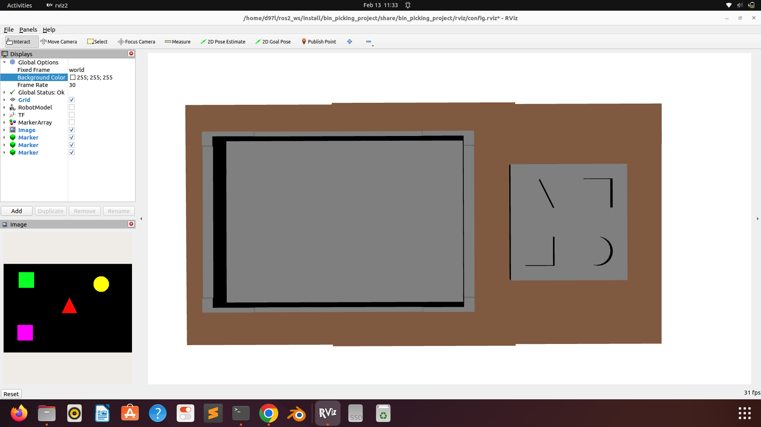
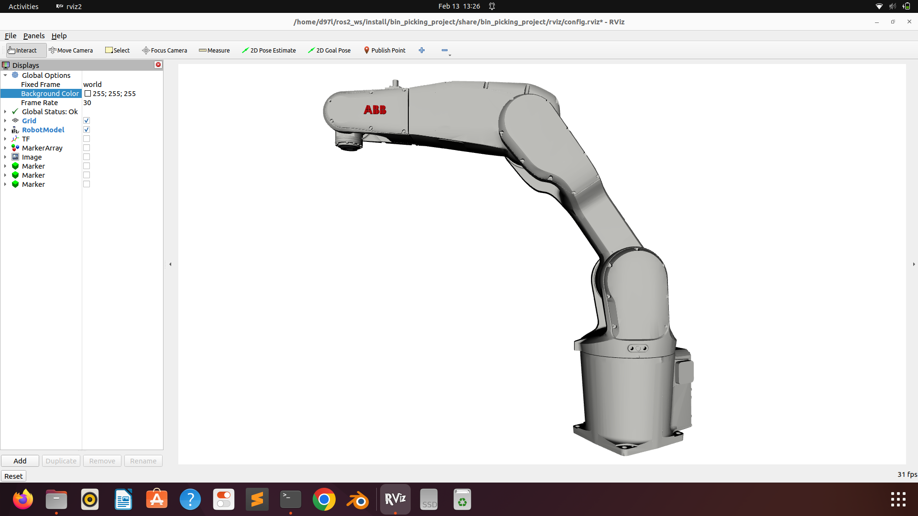
Prototyping Project
Bin Picking
Environment - Robot model and staffage objects
Robot Model: ABB IRB 1200-5/09:
6 degree of freedom robot with 5 kg payload capacity
Maximum range of 0.9 meters
Joint value limits according to table below
Developed specifically for manufacturing industry
Environment Objects:
Table
→ for starting box of objects and target area
Starting box
Target area
Position of movement | Type of movement | ABB IRB 1200-5/0.9
axis 1 | rotational movement | +170° to -170°
axis 2 | arm movement | +130° to -100°
axis 3 | arm movement | +70° to -200°
axis 4 | wrist movement | +270° to -270°
axis 5 | tilt movement | ±130° (not Hygienic robots) ±128° (Hygienic robots)
axis 6 | rotational movement | Default: +400° to -400° Maximum revolution: ±242 (extended by changing the parameter values in the software)
Credits: ABB Robotics: Product specifications IRB 1200 – reachable joint workspace
https://library.e.abb.com/public/52b343c24a894176a5f3c3617a9e6be3/3HAC046982%20PS%20IRB%201200%20on%20IRC5-de.pdf
accessed 13/02/2022, slide by Timur Kuzu, Dominik Leitner and Orhun Oezcan

Slide 7
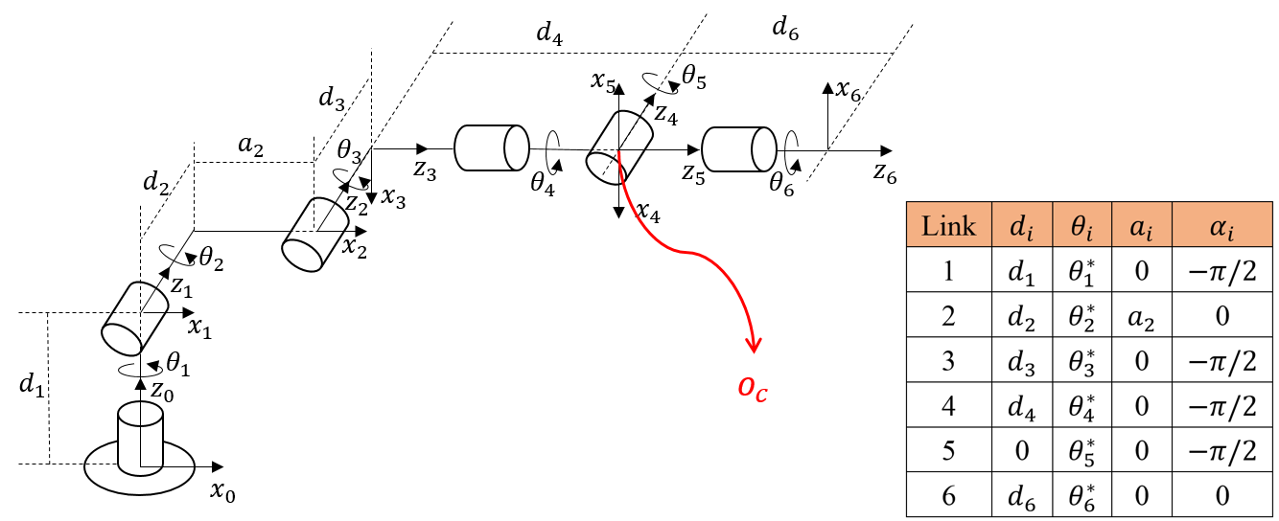
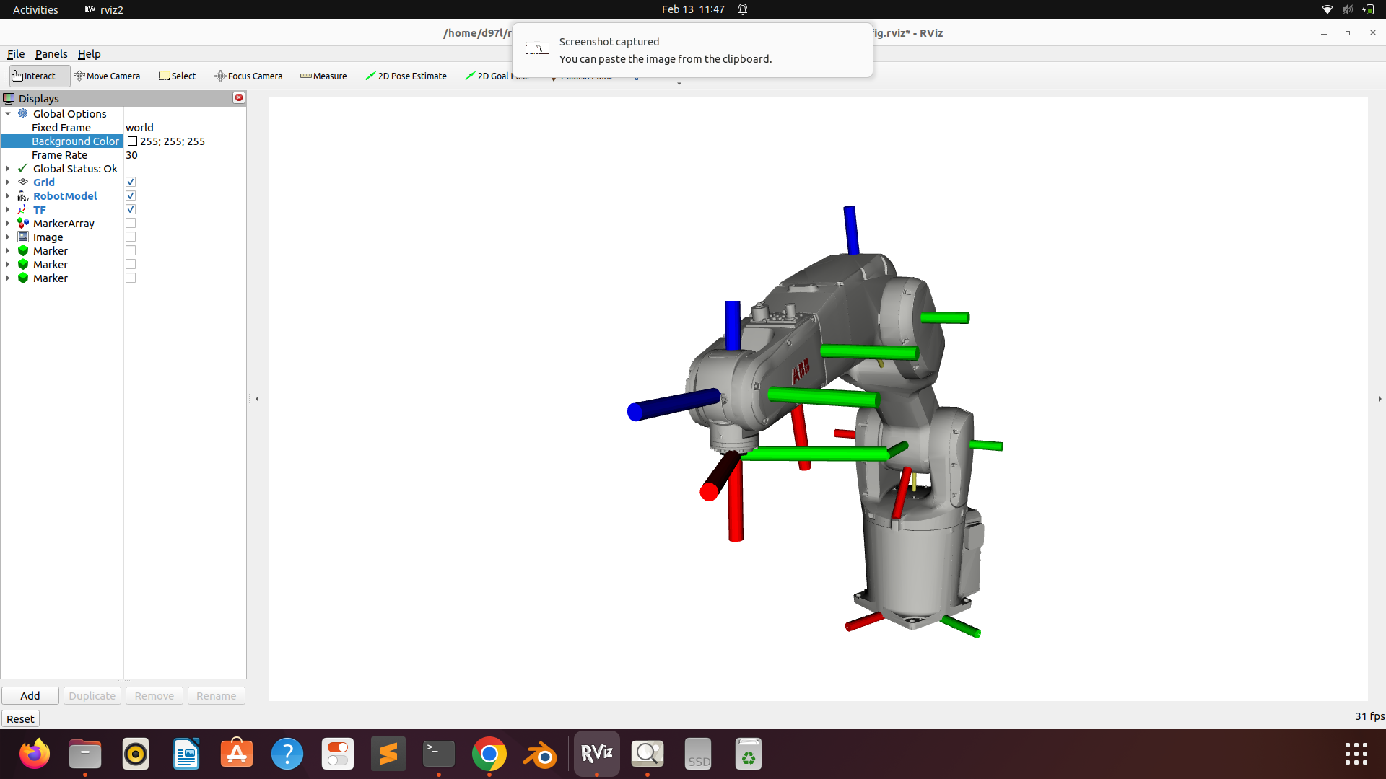
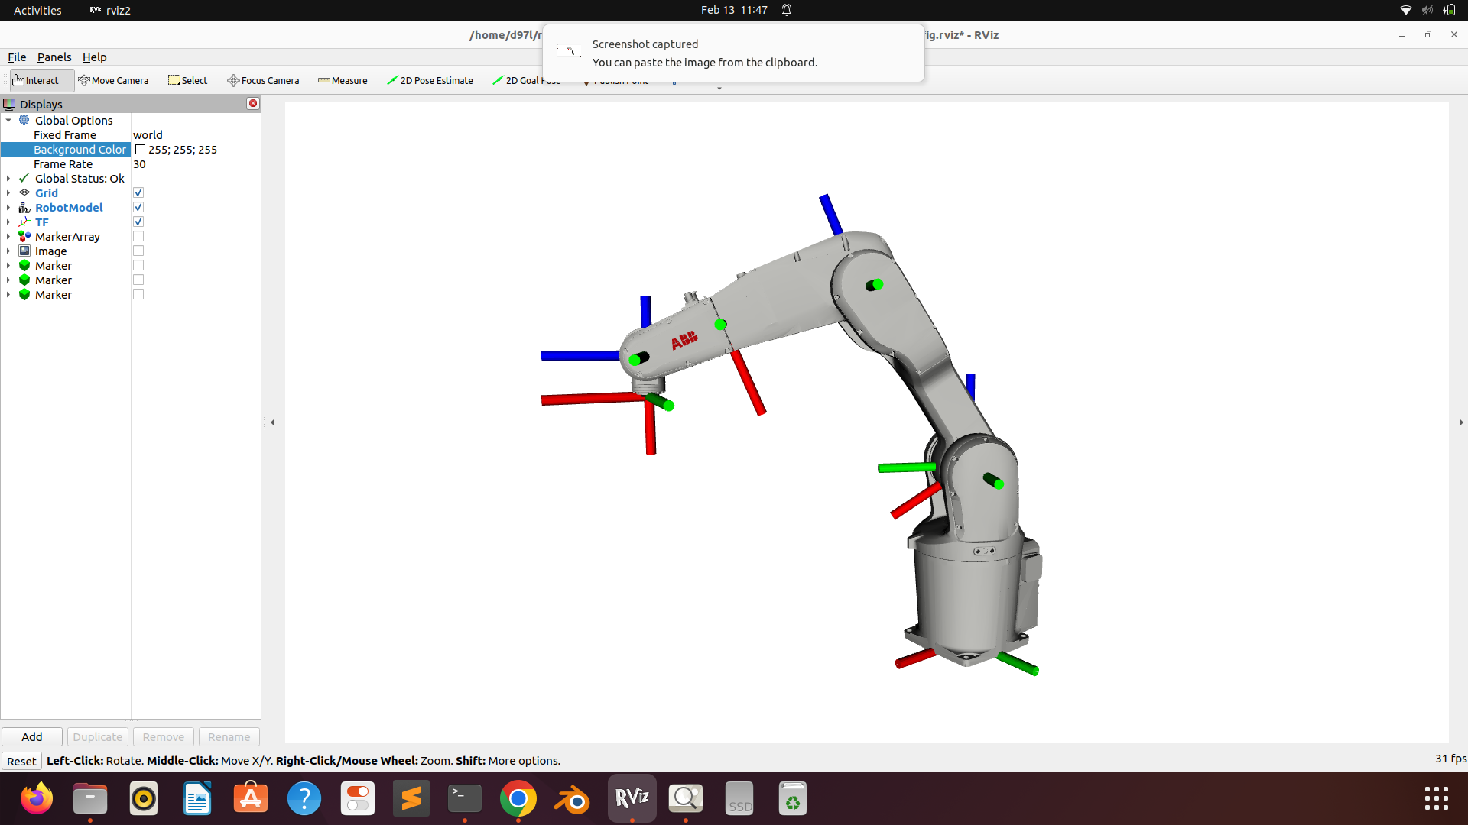
Prototyping Project
Bin Picking
Movement planning - kinematics and path planning
Inverse Kinematics - obtain analytical solutions through geometric methods:
prerequisites for this strategy:
Spherical wrist: last three joints are revolute joints
Wrist centre: their axis of rotation intersecting in one point
Path Planning:
Outputs the path/movement between start, object (centre) and target position
Movement is divided into 50 sub-movements to create a smooth robot motion
Robot movement sub-tasks:
Compute joint values for target position (IK)
Interpolate joint values between reference points
Move robot to interpolated joint values
Repeat process of movement for each object
Credits: Images by Gao Yichao
https://gaoyichao.com/Xiaotu/?book=math_physics_for_robotics&title=inverse_kinematics ;
accessed 12/02/2023, slide by Timur Kuzu, Dominik Leitner, Orhun Oezcan

Slide 8
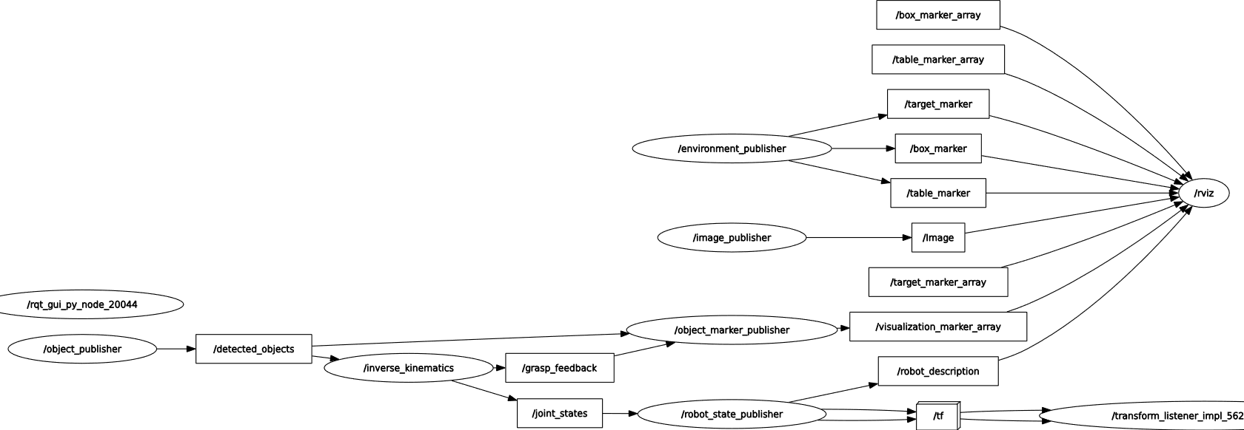
7
Prototyping Project
Bin Picking
Data transfer and Communication
Object Detection
Inverse Kinematics
Movement Feedback
Robot Movement
Object Visualization
Visualization Tool
accessed 13/02/2022, slide by Timur Kuzu, Dominik Leitner and Orhun Oezcan

Slide 9
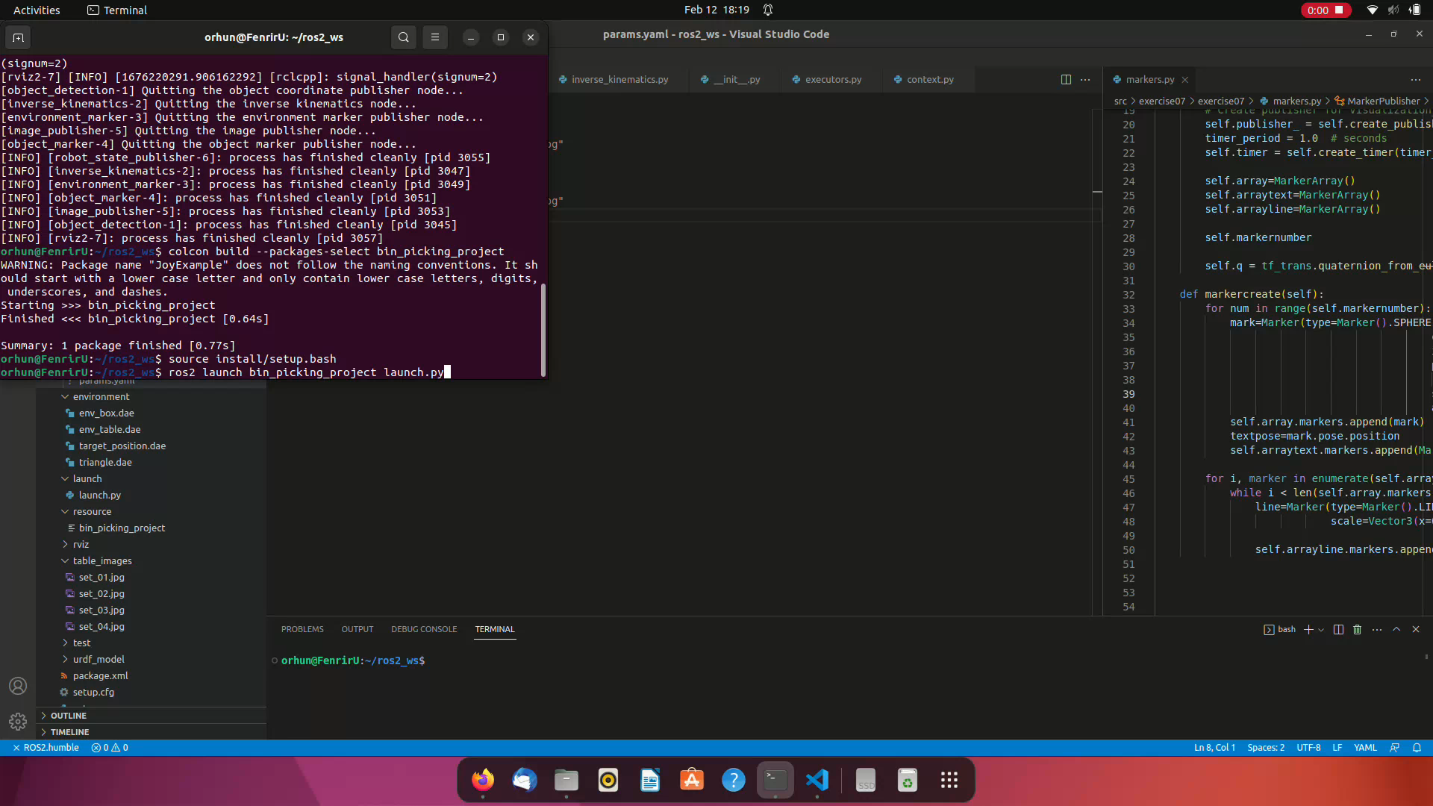
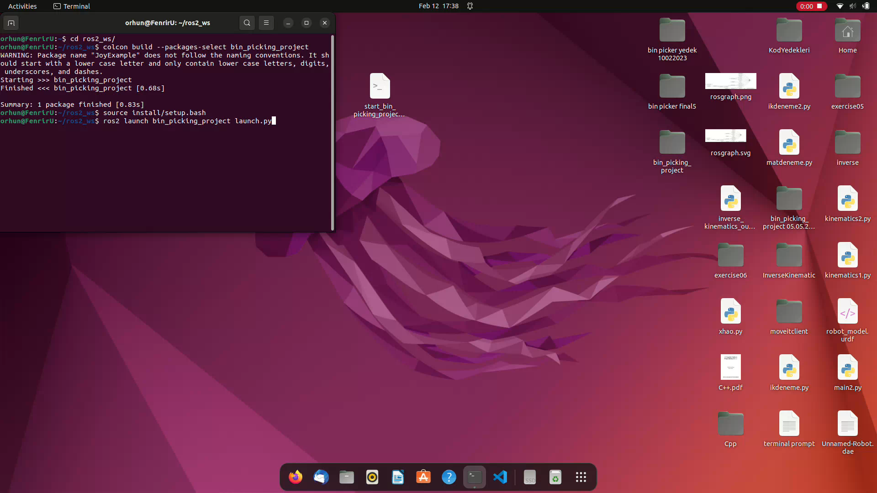
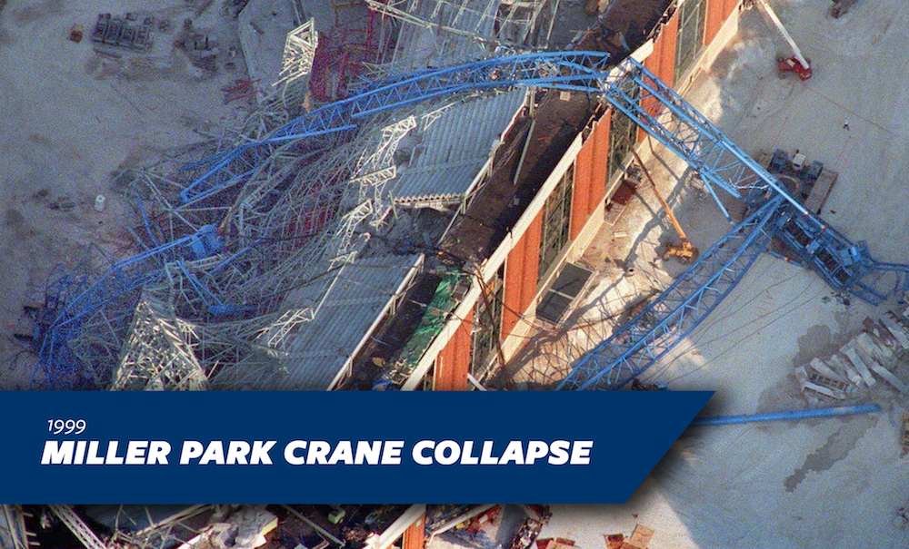
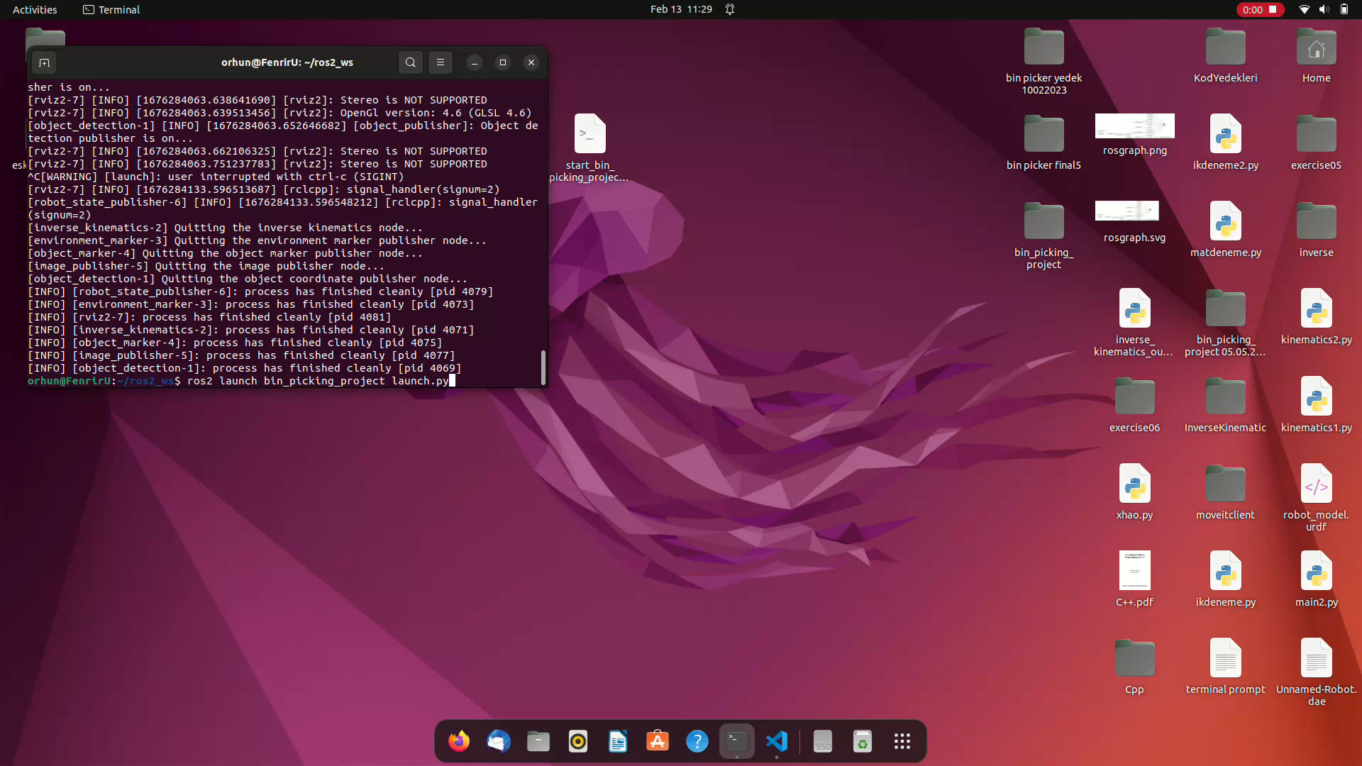
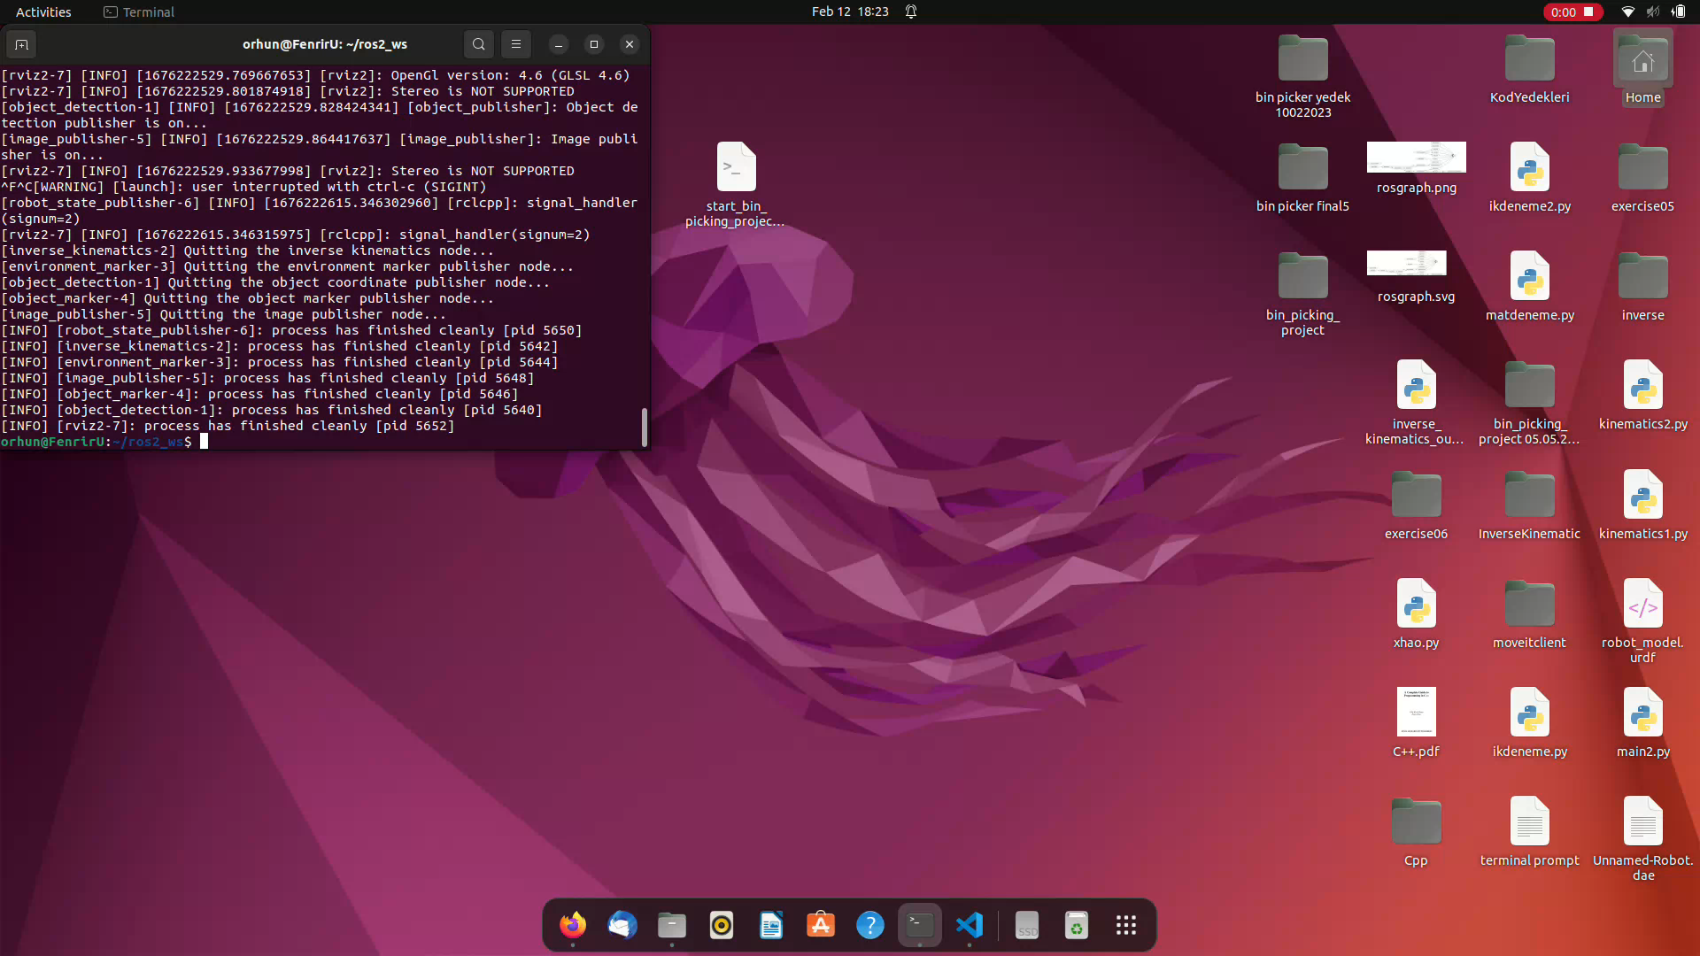
Prototyping Project
Bin Picking
Robot in action
1
2
3
4
accessed 13/02/2022, slide by Timur Kuzu, Dominik Leitner and Orhun Oezcan

Slide 10
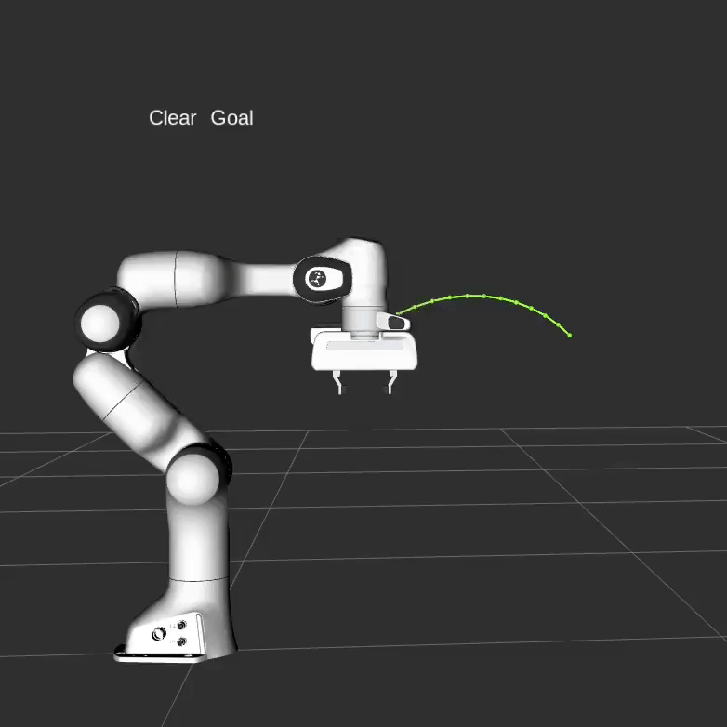
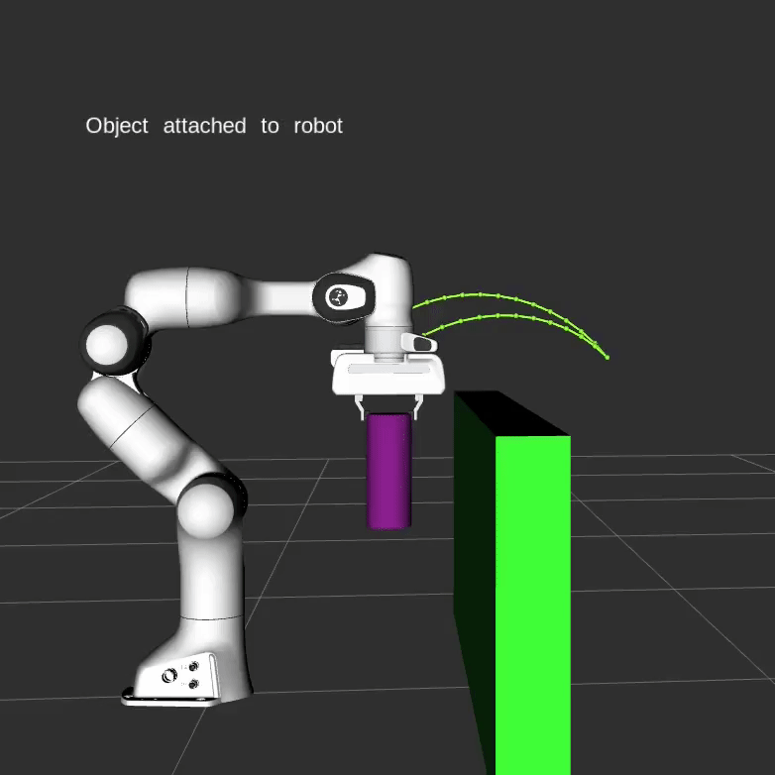
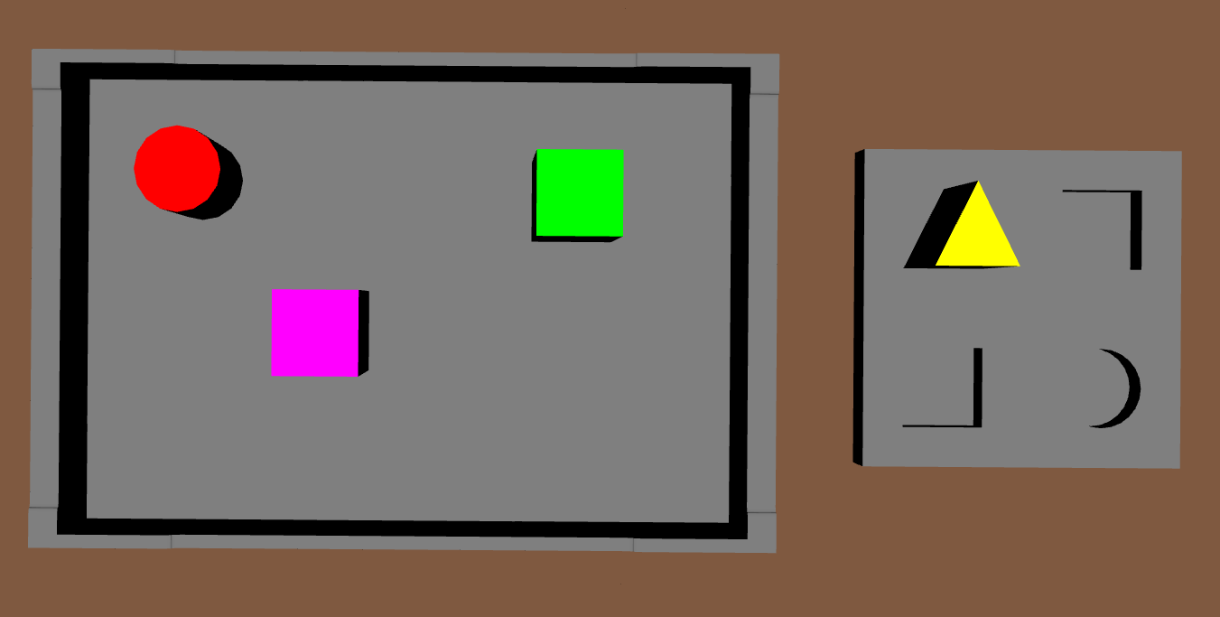
Prototyping Project
Bin Picking
Challenges and future work
Outlook:
Collision prevention
for our application, operation only within pre-determined area
currently solved using safe points
Different gripper - consider rotation of objects
→ avoided by grasping objects from the top
Include additional shapes and colors
shapes and colors predefined in object detection part
Change order that objects are picked
→ user input
Collision prevention
Different gripper - consider rotation of objects
Complex shapes
touchpoint
currently
touchpoints for different gripper
Credits: Images by PickNik Robotics https://moveit.picknik.ai/humble/doc/examples/move_group_interface/move_group_interface_tutorial.html ;
accessed 13/02/2022, slide by Timur Kuzu, Dominik Leitner and Orhun Oezcan

Slide 11

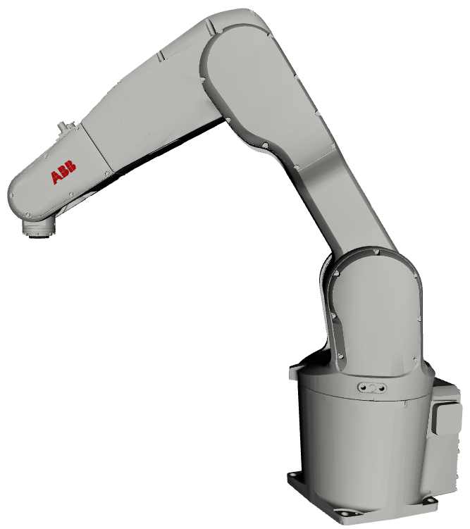
Prototyping Project
Bin Picking
Timur Kuzu
Dominik Leitner
Orhun Oezcan
O
THANK Y U

